Slide 1
Constraints on minimal Z' models from SO(10) GUTs
Paweł Pachołek IFT UW
Scalars 2011 Warsaw 27.08.2011

Slide 2
Outline
Motivation
Z’ models as low energy limits of GUT models
Parametrization in Z’ models
RGE’s for gauge couplings in models with more than one U(1) group
Constraints from gauge coupling unification(s)
Adding experimental constraints
Summary and conclusions

Slide 3
Motivation
Additional U(1) group can naturally appear after breaking a GUT group of rank greater than 4. This is always the case except for the minimal unification to SU(5) (rank 4). SO(10) has rank 5 and E6 has rank 6.
It’s worth to know what region in parameter-space of Z’ models is consistent with Grand Unification.
For minimal Z’ models the smallest possible simple unification gauge group is SO(10).
Can we embedd a minimal Z’ model with relatively light Z’ boson into SO(10) GUT model?
Treshold corrections are included in a general, potential-independent analysis of such an embedding.

Slide 4
What is a minimal Z’ model ?
The gauge group is SM x U(1)
Additional U(1) gauge group is related to B-L.
Only in this case no additional fermions (except for right-handed neutrinos) are needed for anomaly cancelation.
Z’ boson is the gauge boson of additional U(1).

Slide 5
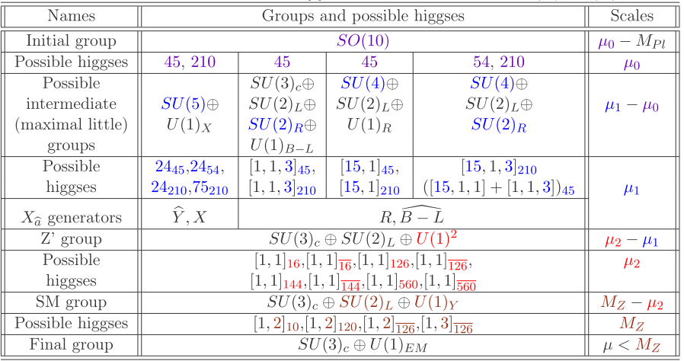
Symmetry breaking

Slide 6
Abelian Lagrange`an

Slide 7
Gauge boson redefinitions

Slide 8
Transformations of G matrix

Slide 9
RGE’s for gauge couplings

Slide 10
Analytic 1-loop solutions

Slide 11
Deriving constraints

Slide 12
Constraints from gauge coupling unification

Slide 13
Treshold corrections

Slide 14
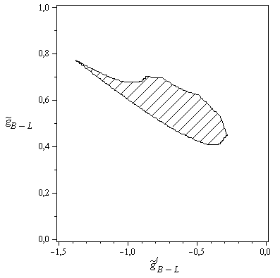
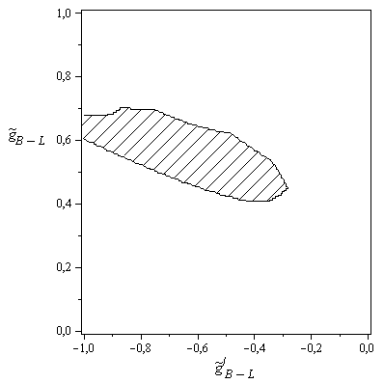

Slide 15
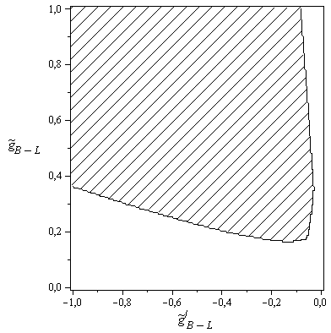

Slide 16
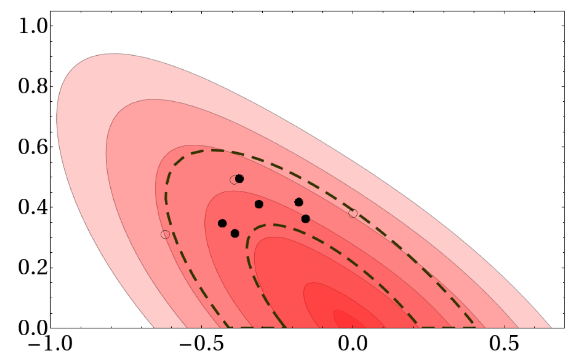
Constraints from LEP II EWPT

Slide 17
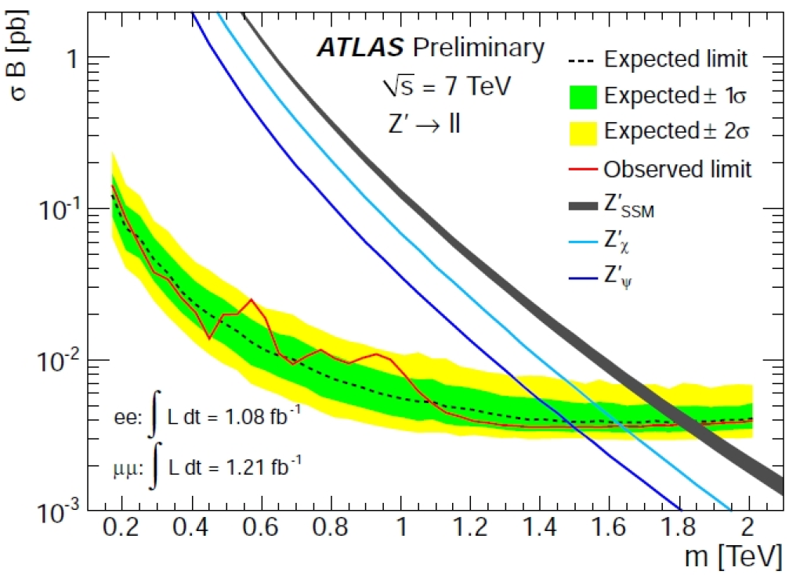
Latest constraints from ATLAS

Slide 18
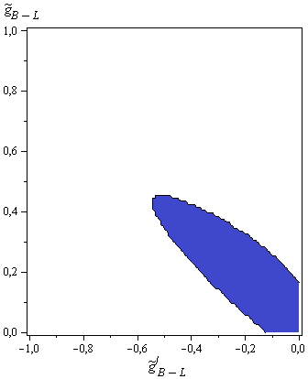
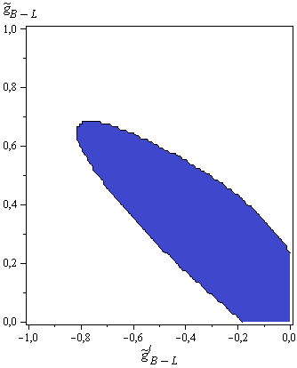
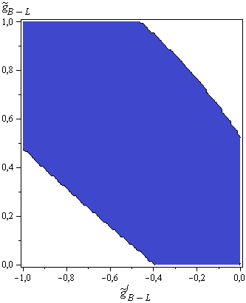
Latest constraints from ATLAS

Slide 19
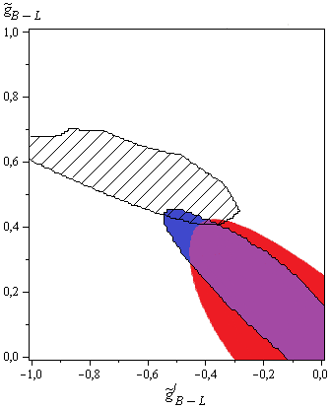
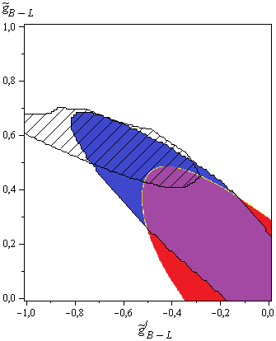
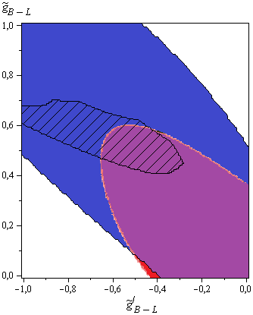
Experimental constraints on Model 1

Slide 20
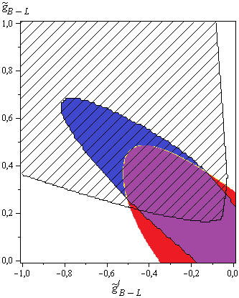
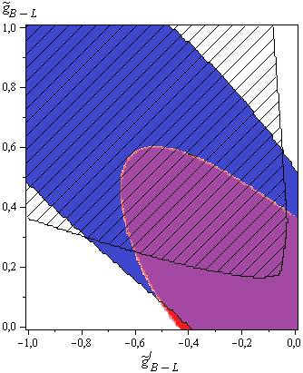
Experimental constraints on Model 2

Slide 21
Summary and conclusions
Grand Unification can significantly constrain the space of parameters in Z’ models, but unknown treshold corrections can give additional freedom.
LHC still didn’t find any Z’, but there are new, stronger limits.
For a given symmetry breaking pattern and a field content, one can find potential-independent, lower bound on Z’ mass.
Presented methods can be used beyond minimal Z’ models unless there are 3 or more U(1)’s at the same range of scales.

Slide 22
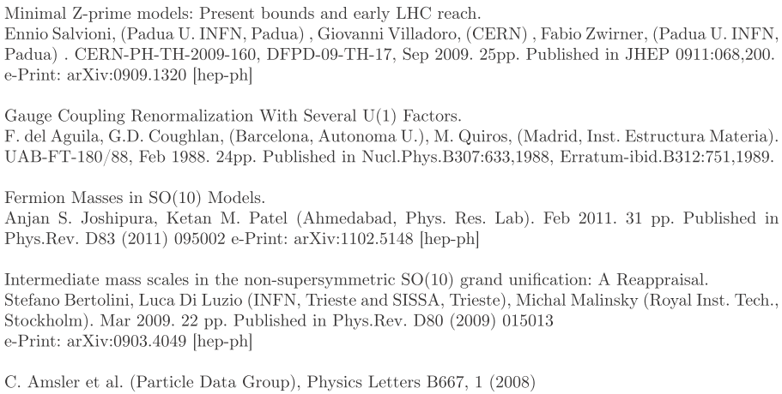
References

